Slide 1
IPv4 Subnetting and Networking Devices
120CT Computer Architecture and Networks
Dr Dianabasi Nkantah
ab0480@coventry.ac.uk

Slide 2
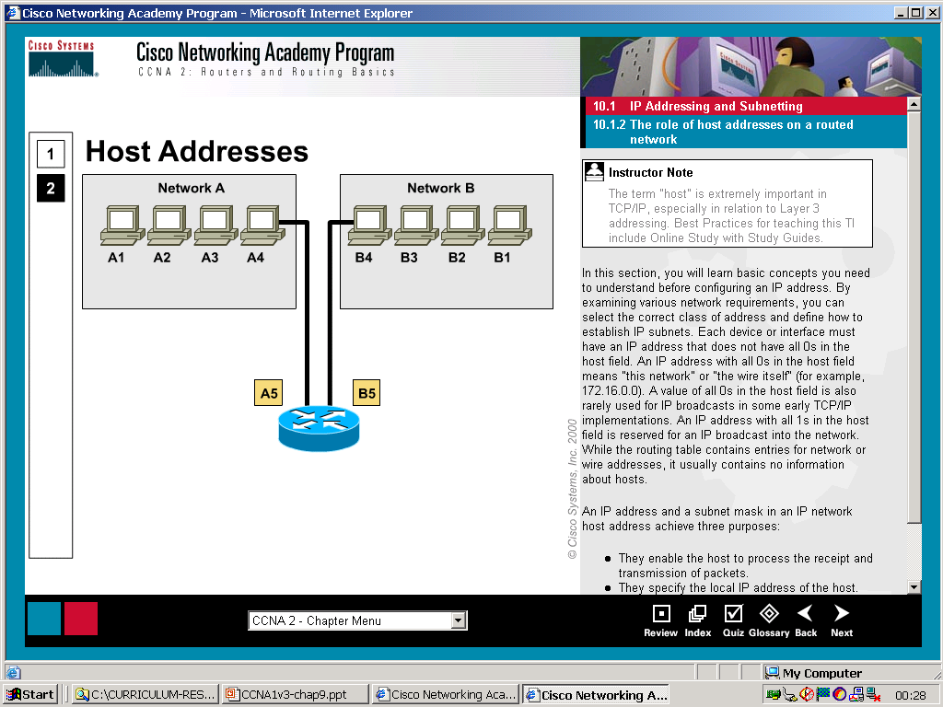
IPv4 Addressing
All hosts on a given network share the same network-prefix but must have a unique host-number.
Similarly, any two hosts on different networks must have different network-prefixes but may have the same host-number.

Slide 3
IPv4 Address Structure
NET ID
HOST ID
32 bit IP address
32 bit binary number.
Divided into four 8 bit octets.
Each octet expressed as a decimal/denary number.
The division between network and host portion determined by length of the subnet mask.

Slide 4
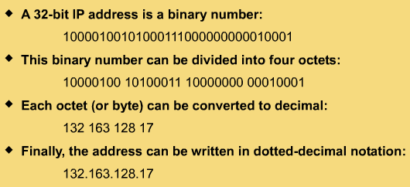
IPv4 Address

Slide 5
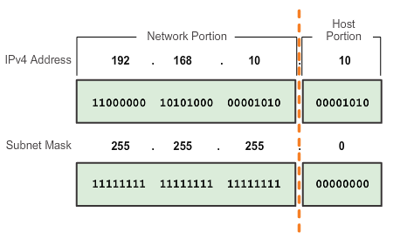
IPv4 Subnet Mask Network Portion and Host Portion of an IPv4 Address
To define the network and host portions of an address, devices use a separate 32-bit pattern called a subnet mask
The subnet mask does not actually contain the network or host portion of an IPv4 address, it just says where to look for these portions in a given IPv4 address

Slide 6
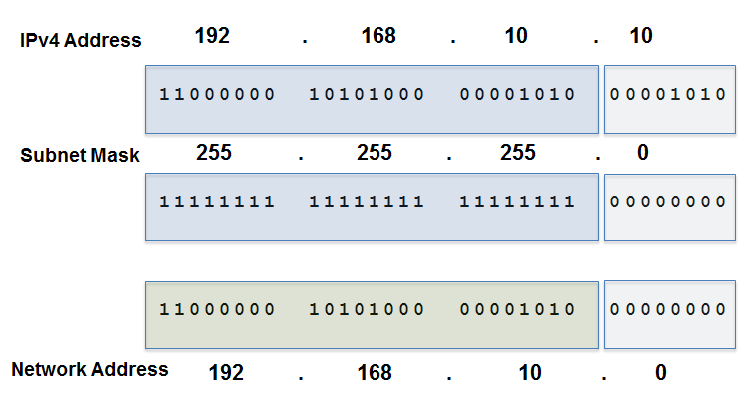
IPv4 Subnet Mask Bitwise AND Operation
1 AND 1 = 1 1 AND 0 = 0 0 AND 1 = 0 0 AND 0 = 0
Notes:
Section 8.1.2.5 and 8.1.2.6

Slide 7
IPv4 Addresses Classes
IP addresses are 32 bits expressions (in binary) divided into four octets
The values of the leftmost four bits of an IPv4 address determine its class
Class A
Class B
Class C
Class D
Class E
IPv4 address space
Class A, B, C Commercial
Class D Multicast
Class E Experimental and Broadcast
Notes:
IP addresses are 32-bit expressions (in binary) divided into four octets (each one of 8 bits).
It is common practice to translate each one of these octets to decimal for easy reading.
The IPv4 address space can be subdivided into 5 classes - Class A, B, C, D and E. Each class consists of a contiguous subset of the overall IPv4 address range. With a few special exceptions explained, the values of the leftmost four bits of an IPv4 address determine its class.

Slide 8
IPv4 Address Classes and the first octet rule
0 8 16 24 31
Class A
0
Net id
Host id
0 8 16 24 31
Class B
1
0
Net id
Host id
0 8 16 24 31
Class C
1
1
0
Net id
Host id

Slide 9
IPv4 Addresses Classes Ranges
Class | Leftmost four bits | Start address | Finish address
A | 0xxx | 0.0.0.0 | 127.255.255.255
B | 10xx | 128.0.0.0 | 191.255.255.255
C | 110x | 192.0.0.0 | 223.255.255.255
D | 1110 | 224.0.0.0 | 239.255.255.255
E | 1111 | 240.0.0.0 | 255.255.255.255
Notes:
IP Address Class E and Limited Broadcast
The IPv4 networking standard defines Class E addresses as reserved, meaning that they should not be used on IP networks. Some research organizations use Class E addresses for experimental purposes. However, nodes that try to use these addresses on the Internet will be unable to communicate properly. A special type of IP address is the limited broadcast address 255.255.255.255. A broadcast involves delivering a message from one sender to many recipients. Senders direct an IP broadcast to 255.255.255.255 to indicate all other nodes on the local network (LAN) should pick up that message. This broadcast is 'limited' in that it does not reach every node on the Internet, only nodes on the LAN.
Technically, IP reserves the entire range of addresses from 255.0.0.0 through 255.255.255.255 for broadcast, and this range should not be considered part of the normal Class E range.
IP Address Class D and Multicast
The IPv4 networking standard defines Class D addresses as reserved for multicast. Multicast is a mechanism for defining groups of nodes and sending IP messages to that group rather than to every node on the LAN (broadcast) or just one other node (unicast). Multicast is mainly used on research networks. As with Class E, Class D addresses should not be used by ordinary nodes on the Internet.
IP Address Class A, Class B, and Class C
Class A, Class B, and Class C are the three classes of addresses used on IP networks in common practice, with three exceptions:
IP Loopback
Private addresses
IPv6 address types

Slide 10
Classless Inter-Domain Routing (CIDR)
Scheme for allocating IP addresses and routing Internet Protocol packets.
Used to replace the “classful” network design in the internet.
Single IP address can be used to denote many IP addresses.
A CIDR IP address ends with a slash followed by a number: /24.

Slide 11
Network Address
Example: IP Address: 193.10.5.1
Subnet Mask: 255.255.255.0
In binary:
IP Address: 11000001.00001010.00000101.00000001
Subnet Mask: 11111111.11111111.11111111.00000000
Network Address: 11000001.00001010.00000101.00000000
193.10.5.0

Slide 12
Broadcast Address
Example: IP Address: 193.10.5.1
Subnet Mask: 255.255.255.0
In binary:
IP Address: 11000001.00001010.00000101.00000001
Subnet Mask: 11111111.11111111.11111111.00000000
Broadcast Address: 11000001.00001010.00000101.11111111
193.10.5.255

Slide 13
Usable Host Range of Addresses
xxxxxxxx.xxxxxxxx.xxxxxxxx.00000001 xxxxxxxx.xxxxxxxx.xxxxxxxx.1
xxxxxxxx.xxxxxxxx.xxxxxxxx.11111110 xxxxxxxx.xxxxxxxx.xxxxxxxx.254
Example: IP Address: 193.10.5.1
Subnet Mask: 255.255.255.0
Network Address: 193.10.5.0
Broadcast Address: 193.10.5.255
Usable host range: 193.10.5.1 193.10.5.254

Slide 14
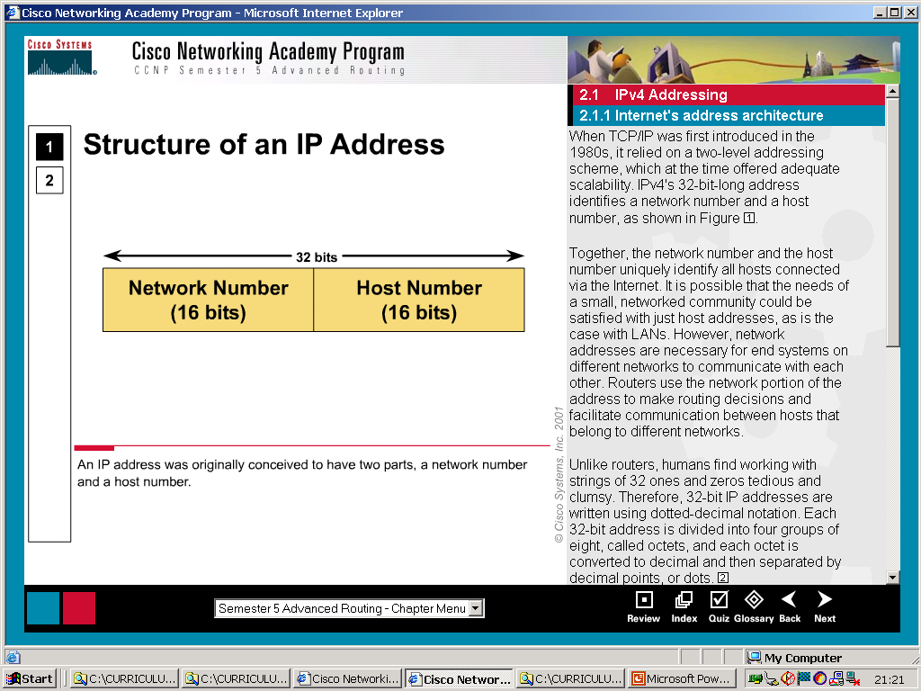
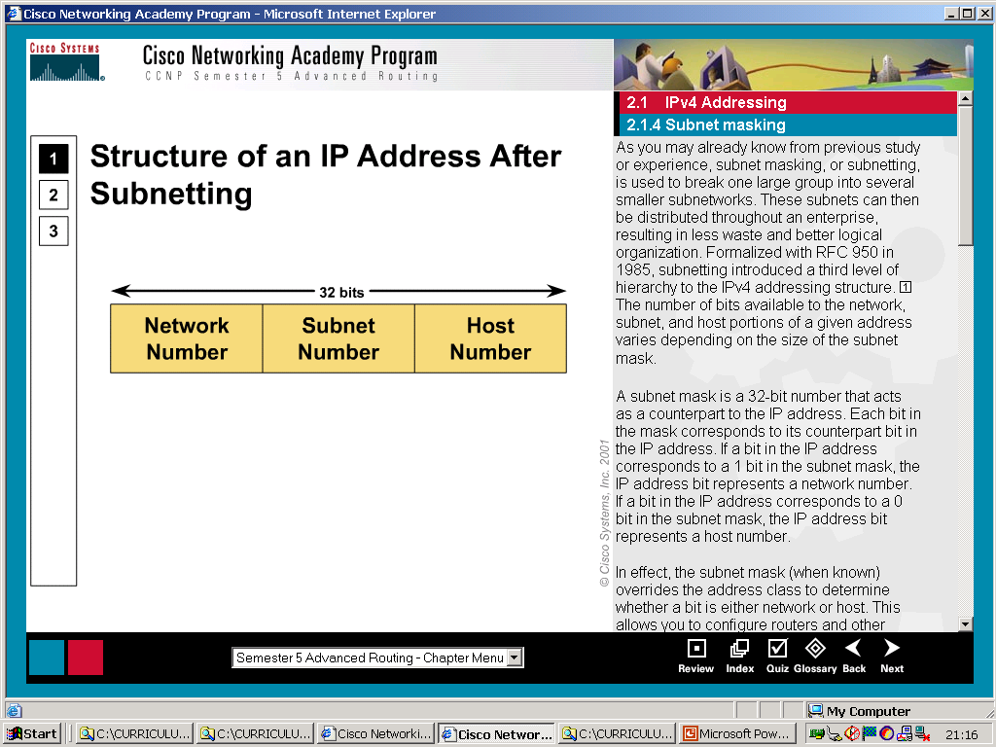
IPv4 Subnetting
Subnetting.
The division of one network address to give multiple usable subnet-work addresses.

Slide 15
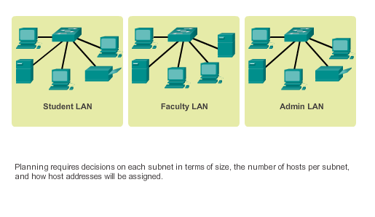
Subnetting an IPv4 Network

Slide 16
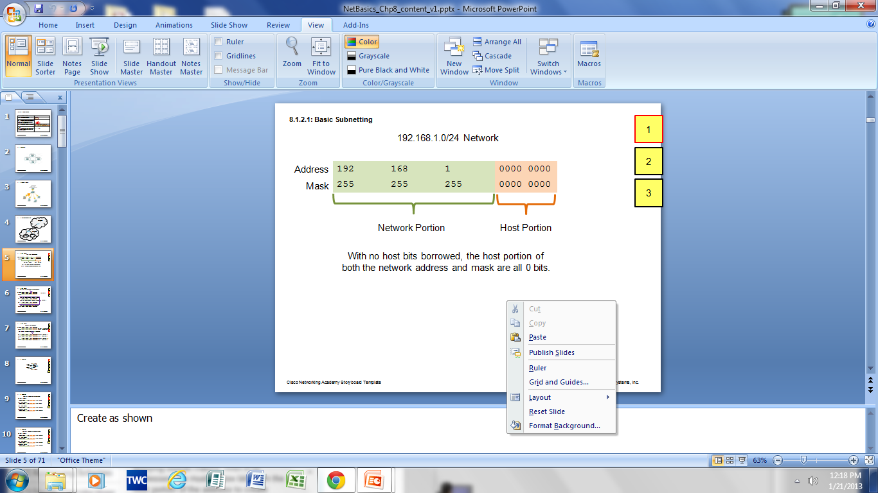
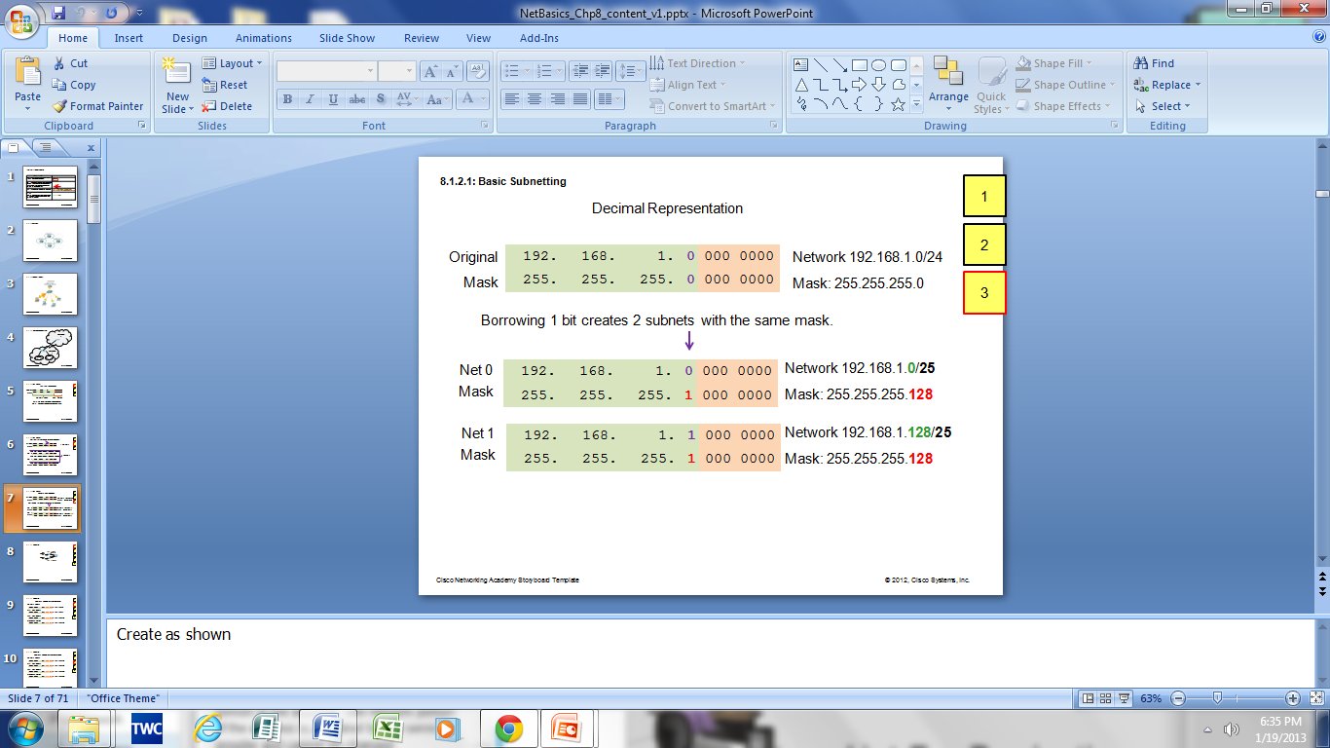
Subnetting an IPv4 Network Basic Subnetting
Borrowing Bits to Create Subnets
Borrowing 1 bit 2¹ = 2 subnets
Borrowing 1 Bit from the host portion creates 2 subnets with the same subnet mask
Subnet 0
Network 192.168.1.0-127/25
Mask: 255.255.255.128
Subnet 1
Network 192.168.1.128-255/25
Mask: 255.255.255.128

Slide 17
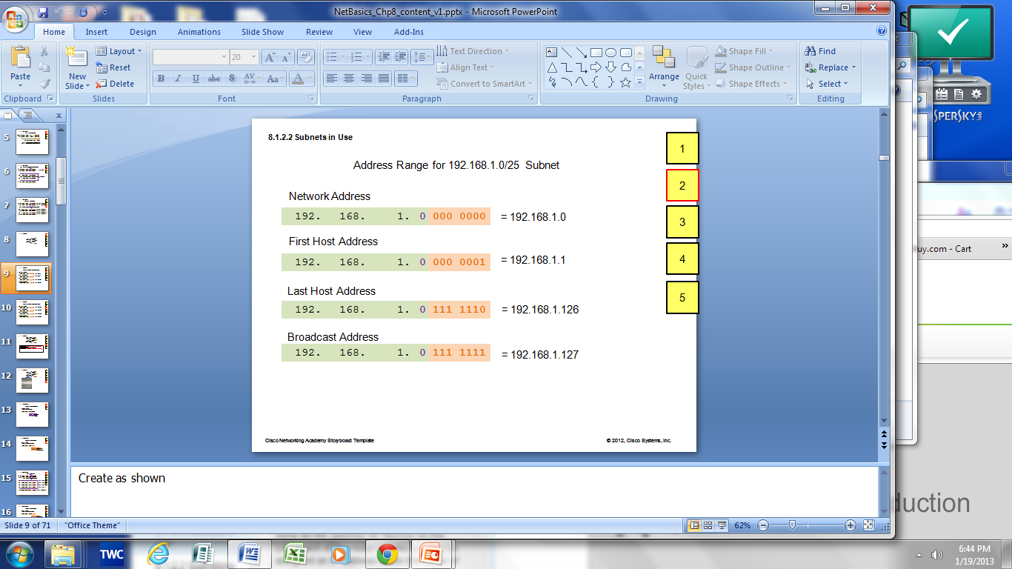
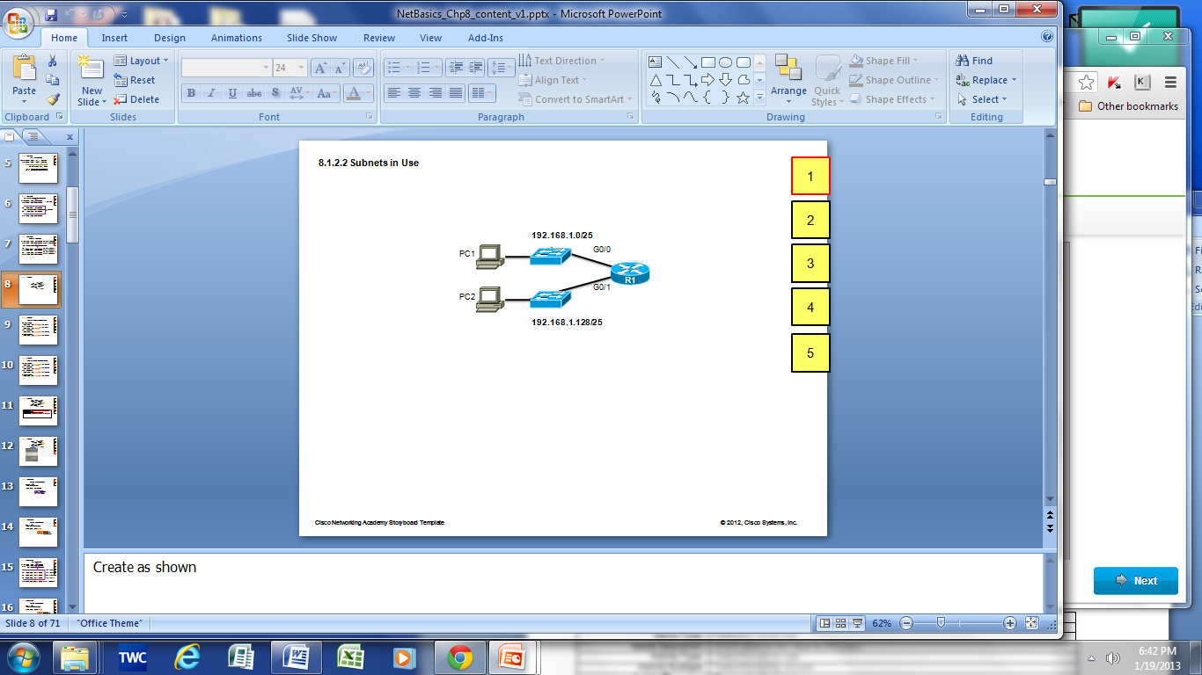

Subnetting an IPv4 Network Subnets in Use
Subnet 0
Network 192.168.1.0-127/25
Subnet 1
Network 192.168.1.128-255/25

Slide 18
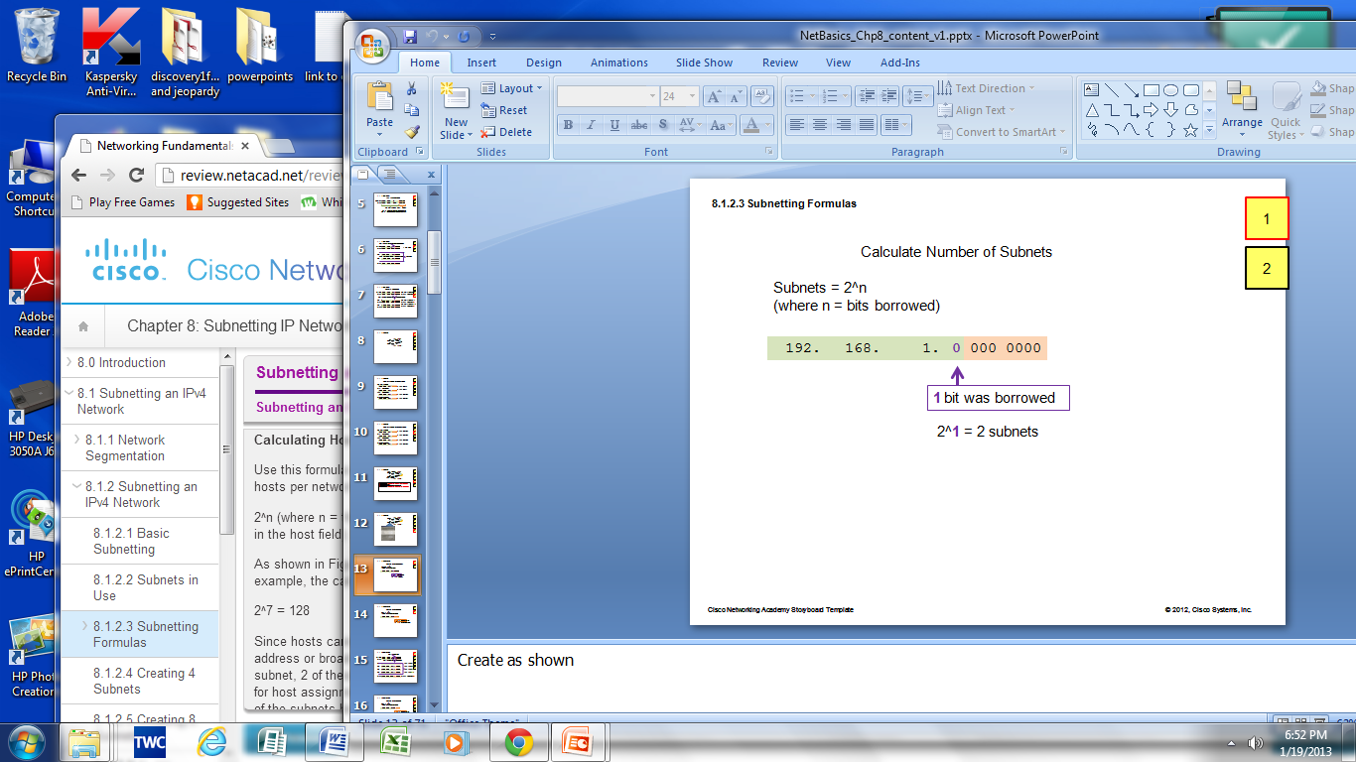
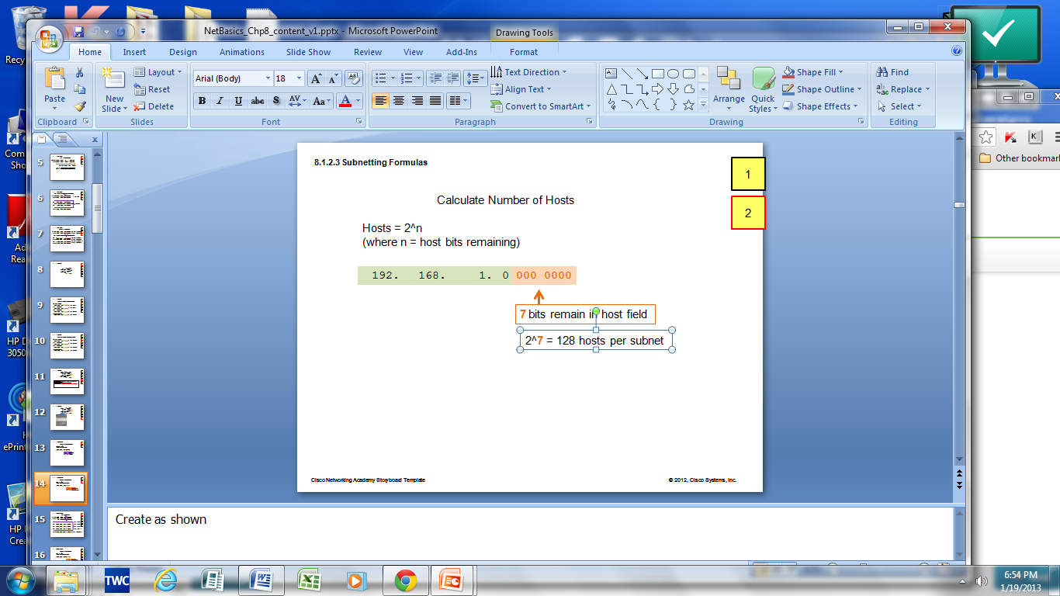
Subnetting an IPv4 Network Subnetting Formulas
Calculate Number of Subnets
Calculate Number of Hosts

Slide 19
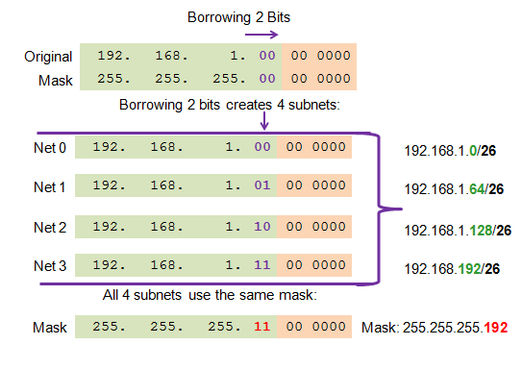
Subnetting an IPv4 Network Creating 4 Subnets
Borrowing 2 bits to create 4 subnets. 2² = 4 subnets

Slide 20
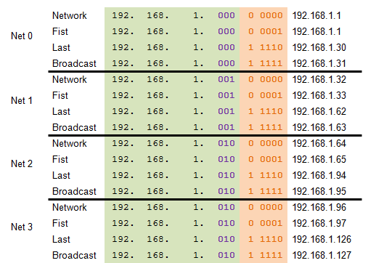
Subnetting an IPv4 Network Creating 8 Subnets
Borrowing 3 bits to Create 8 Subnets. 2³ = 8 subnets
0

Slide 21
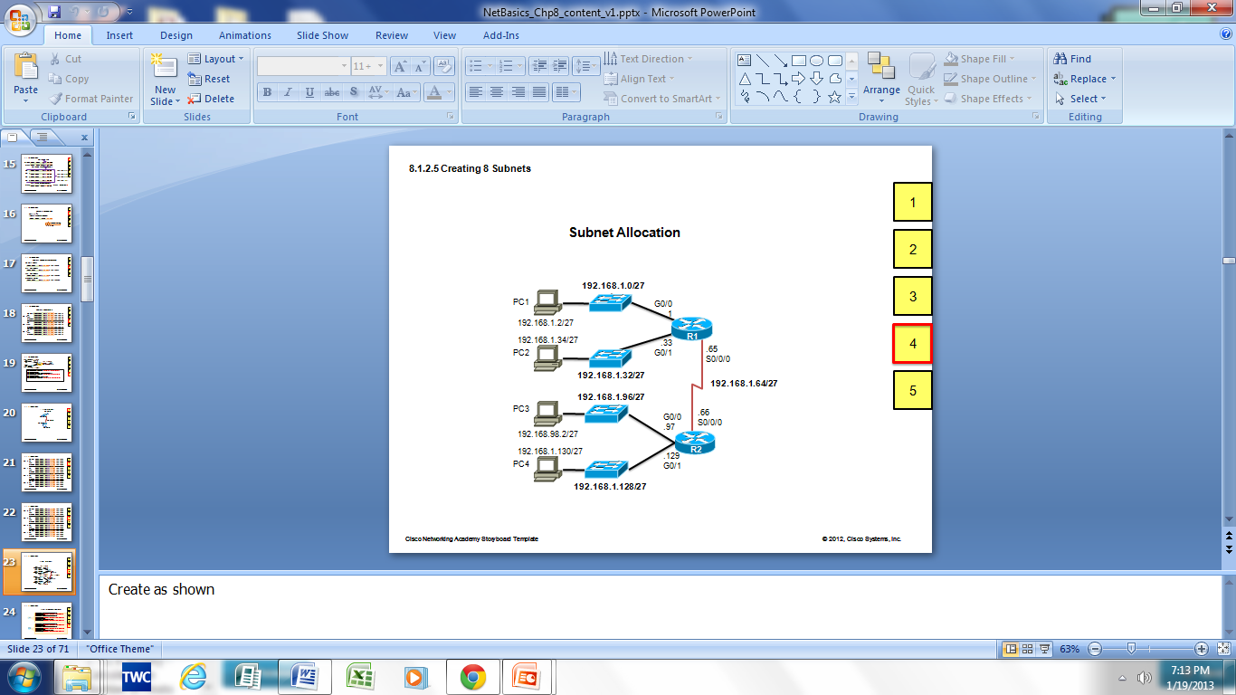
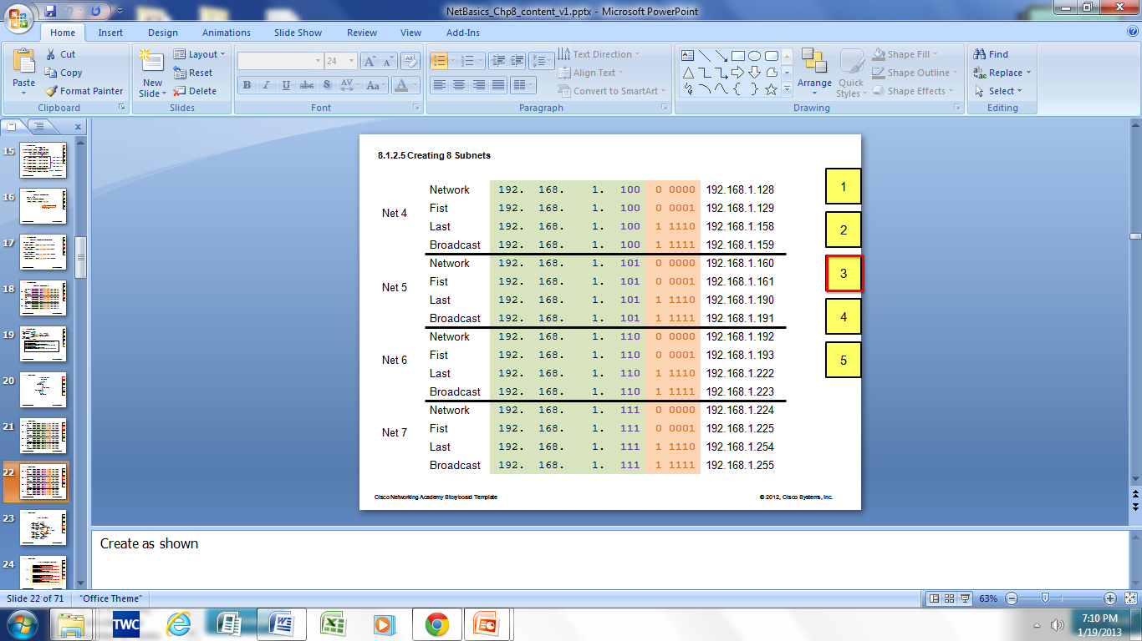
Subnetting an IPv4 Network Creating 8 Subnets(continued)

Slide 22
Determining the Subnet Mask Subnetting Based on Host Requirements
There are two considerations when planning subnets:
Number of Subnets required
Number of Host addresses required
Formula to determine number of useable hosts
2^{n} - 2
2^{n} (where n is the number the number of host bits remaining) is used to calculate the number of hosts
-2 Subnetwork ID and broadcast address cannot be used on each subnet

Slide 23
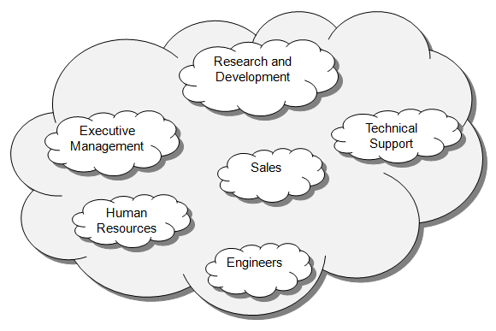
Determining the Subnet Mask Subnetting Network-Based Requirements
Calculate number of subnets
Formula 2^{n} (where n is the number of bits borrowed)
Subnet needed for each department in graphic

Slide 24
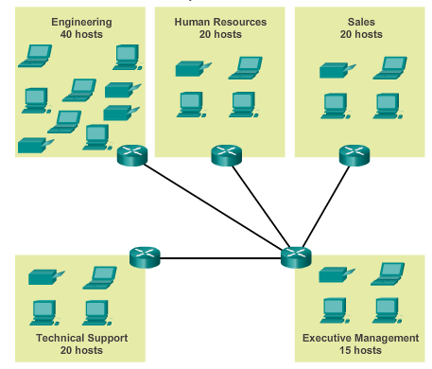
Determining the Subnet Mask Subnetting To Meet Network Requirements
It is important to balance the number of subnets needed and the number of hosts required for the largest subnet.
Design the addressing scheme to accommodate the maximum number of hosts for each subnet.
Allow for growth in
each subnet.
Notes:
9.1.4.3 Subnetting to Meet Network Requirements

Slide 25
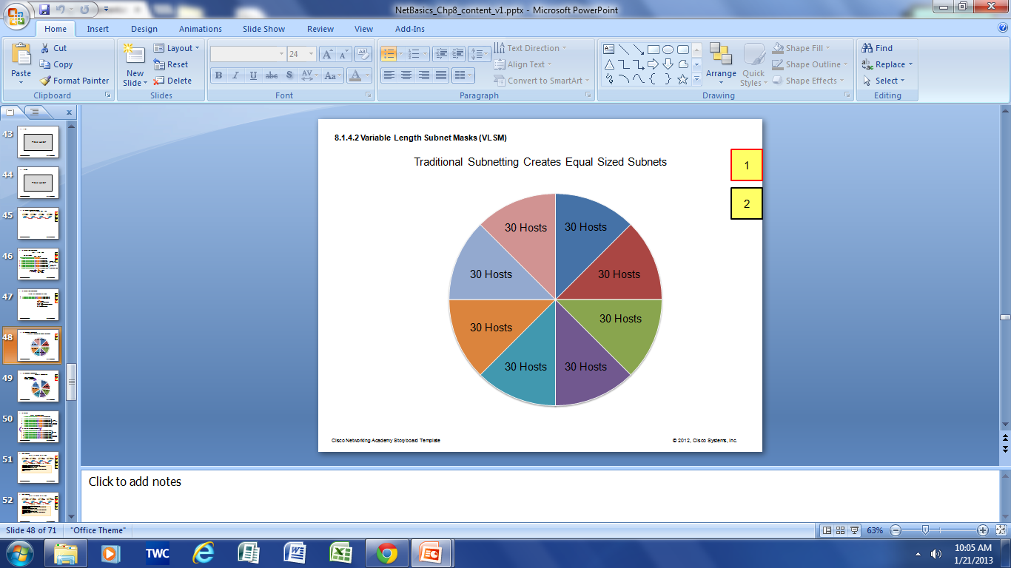
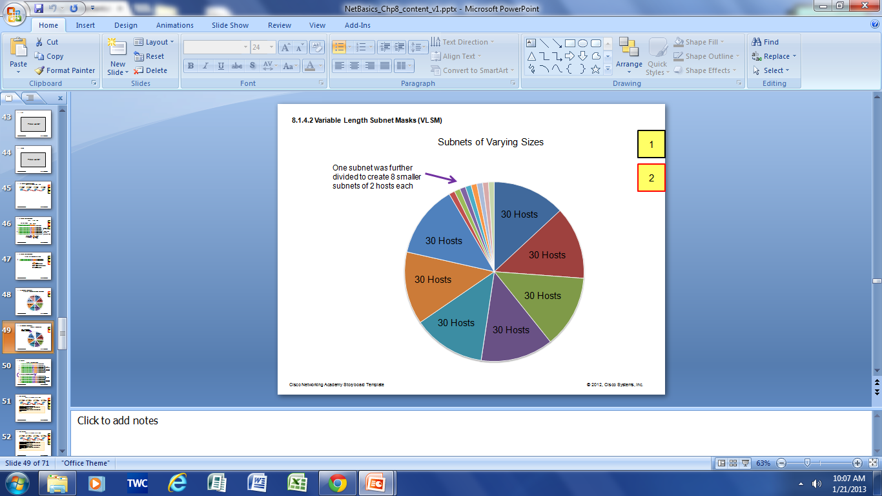
Benefits of Variable Length Subnet Masking Traditional Subnetting Wastes Addresses
Traditional subnetting - same number of addresses is allocated for each subnet.
Subnets that require fewer addresses have unused (wasted) addresses. For example, WAN links only need 2 addresses.
Variable Length Subnet Mask (VLSM) or subnetting a subnet provides more efficient use of addresses.

Slide 26
Benefits of Variable Length Subnet Masking Variable Length Subnet Masks (VLSM)
VLSM allows a network space to be divided in unequal parts.
Subnet mask will vary depending on how many bits have been borrowed for a particular subnet.
Network is first subnetted, and then the subnets are subnetted again.
Process repeated as necessary to create subnets of various sizes.

Slide 27
Network Devices
Networks consist of more than just computers and cables
Intermediate devices are needed to help connect things together and perform useful functions in the network
These can be associated with particular layers of the ISO/OSI and TCP/IP models depending on how they operate

Slide 28
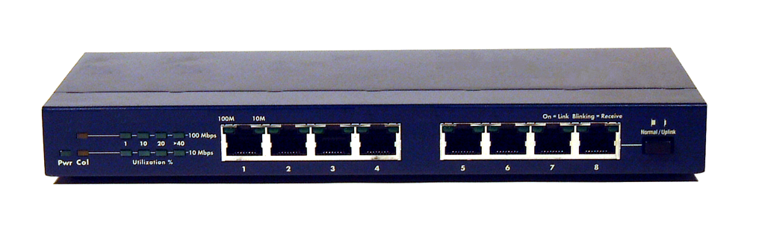
Layer 1 Devices
On the physical layer of the ISO/OSI model:
Repeaters: simple two port devices whose sole purpose is to amplify the signal so it can travel farther
Hubs: Multi port device - what come into one port goes out of every other port
Active (as opposed to passive) hubs also reinforce signal
Hub

Slide 29
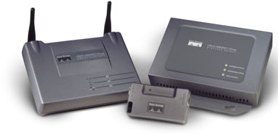
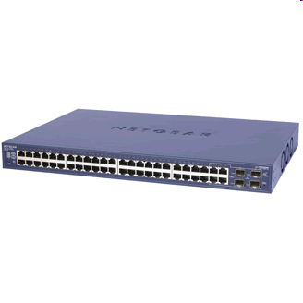
Layer 2 Devices
Data-link layer devices use MAC addresses to filter frames
Bridges: two ports, can be used to split a network in areas
Switches: in essence multi-port bridges, offer much better performance than the simpler hubs
Bridges
Switch

Slide 30
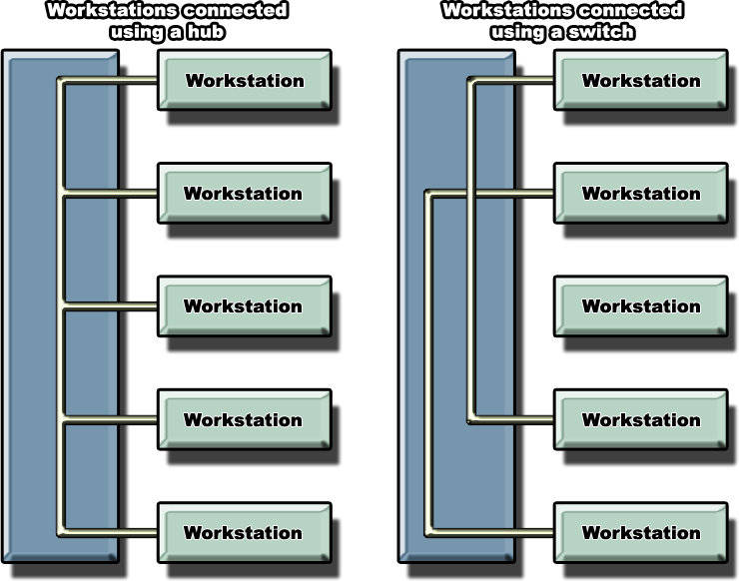
Hub vs Switch
Switches allow simultaneous communication amongst devices connected to different ports
Thus they can break a network to different collision domains
Hub operates like a bus on the logical level

Slide 31
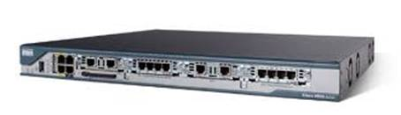
Layer 3 Devices
Routers: use network layer addresses (such as IP) to make intelligent decisions as to where to forward packets next
Multiport devices typically used to connect different networks or sub-networks together
Employ special protocols for exchanging information with other routers in order to learn about faraway networks

Slide 32
Routers and packet forwarding
Routers maintain a routing table – a list of which network can be reached through which port
Entries can be added by an administrator
Or learned through exchanging information with other routers
If no entry exist, then packets are either dropped or forwarded out of a default gateway
Hopefully the next router might know
Network Port
10.0.0.0 Fa0/0
192.168.1.0 Fa0/1
172.10.0.0 S0/0
173.11.0.0 S0/0
172.11.0.0 S0/1
172.20.0.0 S0/1
Simplified
Routing table

Slide 33
Advantages of Routers
Typically thought of as wide area devices, today they are also often employed in LANs (especially large ones)
Messages only go where they need to go (better bandwidth use)
Break network into smaller areas improving performance and isolating problems
Can be used to set rules as to who can access what improving security

Slide 34
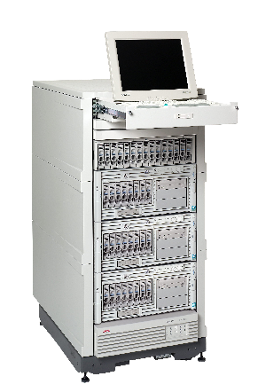
Devices Layers 1-7
Devices such as servers perform specialized functions such as offering particular services
Special devices dealing with problems such as content filtering (i.e. content switches, firewalls)
Etc.
Server / Gateway

Slide 35

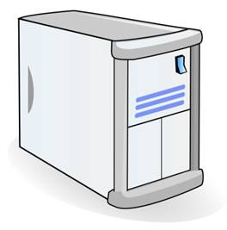
DNS
A very useful service provided at the application layer is that of the Domain Name Server (DNS)
Humans not good at remembering strings of numbers
Computers have trouble understanding words!
A DNS server keeps records mapping host names with their corresponding IP addresses (DNS table)
www.google.com
DNS
Server
Computer
173.194.78.105

Slide 36
Other Useful Services
The World Wide Web uses the HTTP protocol
Remote access programs use the Telnet protocol for directly connecting to remote resources
E-mail programs support the POP3, IMAP and SMTP application layer protocols for electronic mail
File utility programs use the FTP protocol for copying and moving files between remote sites
Network data gathering and monitoring use the SNMP protocol
Etc.

Slide 37
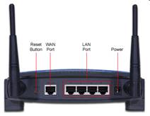
Home Devices
Often in order to keep cost down, home devices combine the functionality of multiple devices
For instance a wireless ADSL router consists of:
A wireless access point
An Ethernet switch
A router
A DSL modem
Wireless Router

Slide 38
Device Deployment
Typically combo-devices such as the one in the previous slide used at homes
Switches is by far the most widespread LAN device
Fairly cheap, offering good performance and lots of ports
Routers can be used both for LANs and WANs
Small LANs a single one on the border connected to the outside world
Large LANs might employ many as they can be used to improve performance and security
WANs use routers for making packet forwarding decisions and connecting different technologies and media together
Servers often found in LANs but even more often reside outside and are accessible through the WAN infrastructure

Slide 39
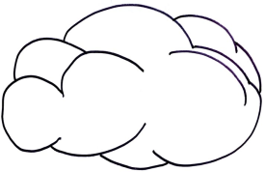
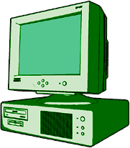
Sending a Message
170.22.0.0 unknown, send out through default gateway
Can reach 170.22.0.0 via port 3
170.22.0.0 is directly connected to me
Router 1
Router 2
Router 3
Internet
From: 132.99.22.6
To: 170.22.12.3
Got message
Sending to 170.22.12.3

Slide 40
Further Reading
Computer Networking: A Top-Down Approach (6th Edition), James F. Kurose and Keith W. Ross [Chapter: 4]

